Slide 1
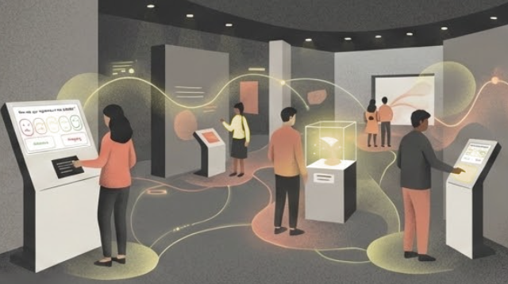
Museum Visitor Insights
Liverpool Museum of Natural History
Smiley Face Survey Kiosks
Feb 2026
Notes:
LMNH's core mission is 'to provide value to the Liverpool community and the wider public'. As part of this mission, the museum regularly collects data on visitor satisfaction and wellbeing, which is then used to target exhibition development and maintenance
The kiosks have been placed at the exits of the exhibitions; visitors are asked to rate their experience of the exhibition on a five-point scale (from 😡 to 😀). Each kiosk features two other buttons: an "assistance" button, for general enquiries, and an "emergency" button for immediate support.

Slide 2
Liverpool Museum of Natural History
Contents
1.
An overview of the project and its goals
2.
A summary of your approach and the decisions you made
3.
Key Considerations and Decisions
4.
A summary of your findings from the analysis notebook
5.
Any next steps or future work you would recommend

Slide 3
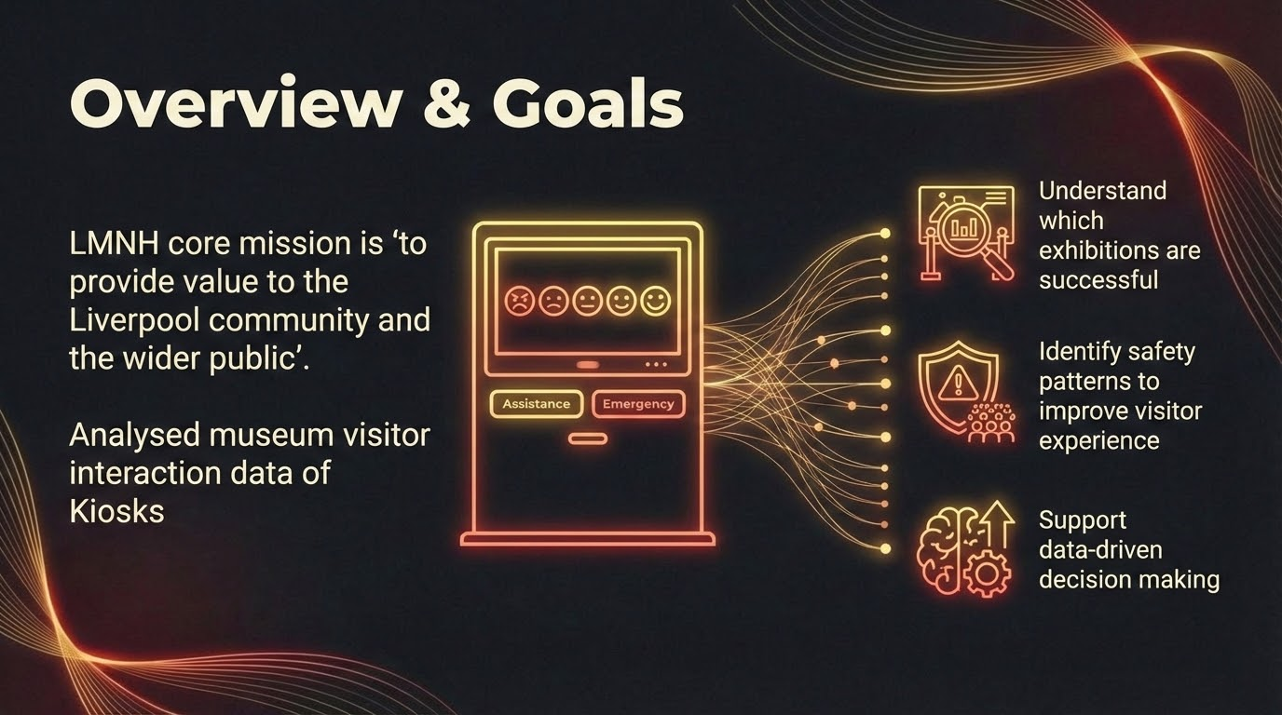

Slide 4
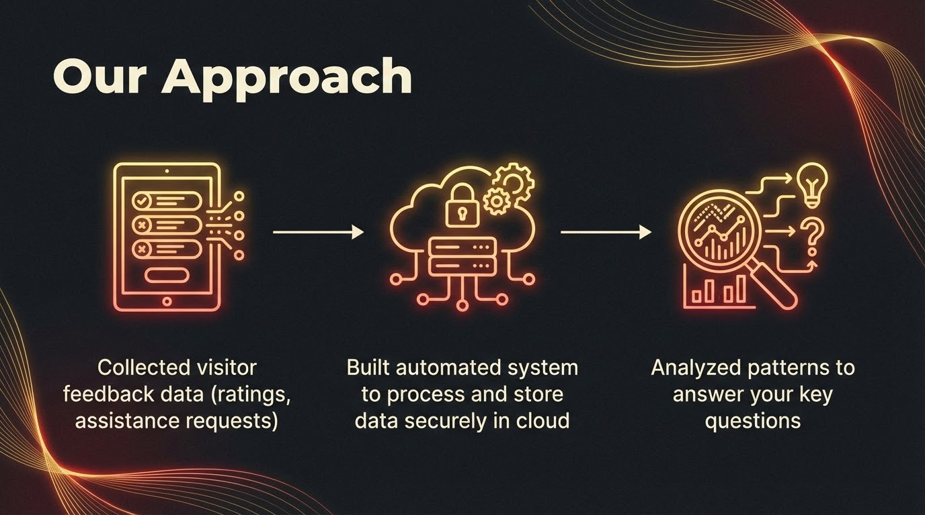

Slide 5
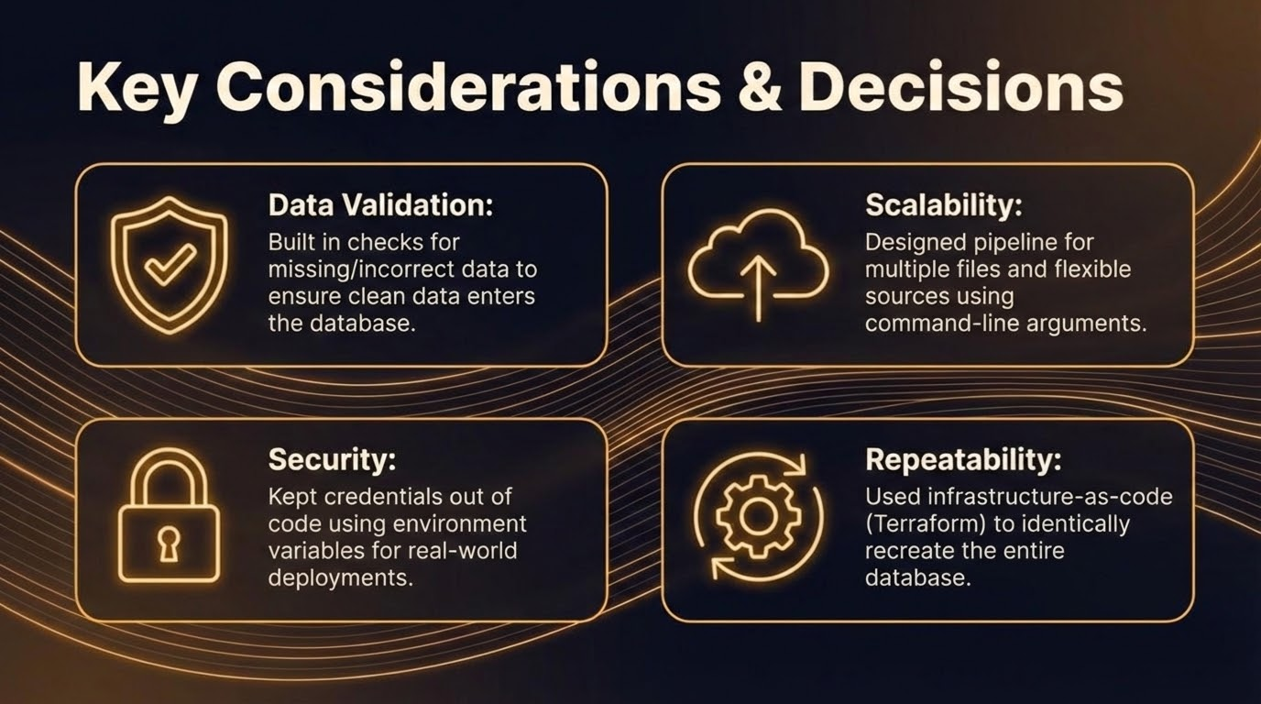

Slide 6
Key Findings
Liverpool Museum of Natural History
Smiley Face Survey Kiosks
Feb 2026

Slide 7
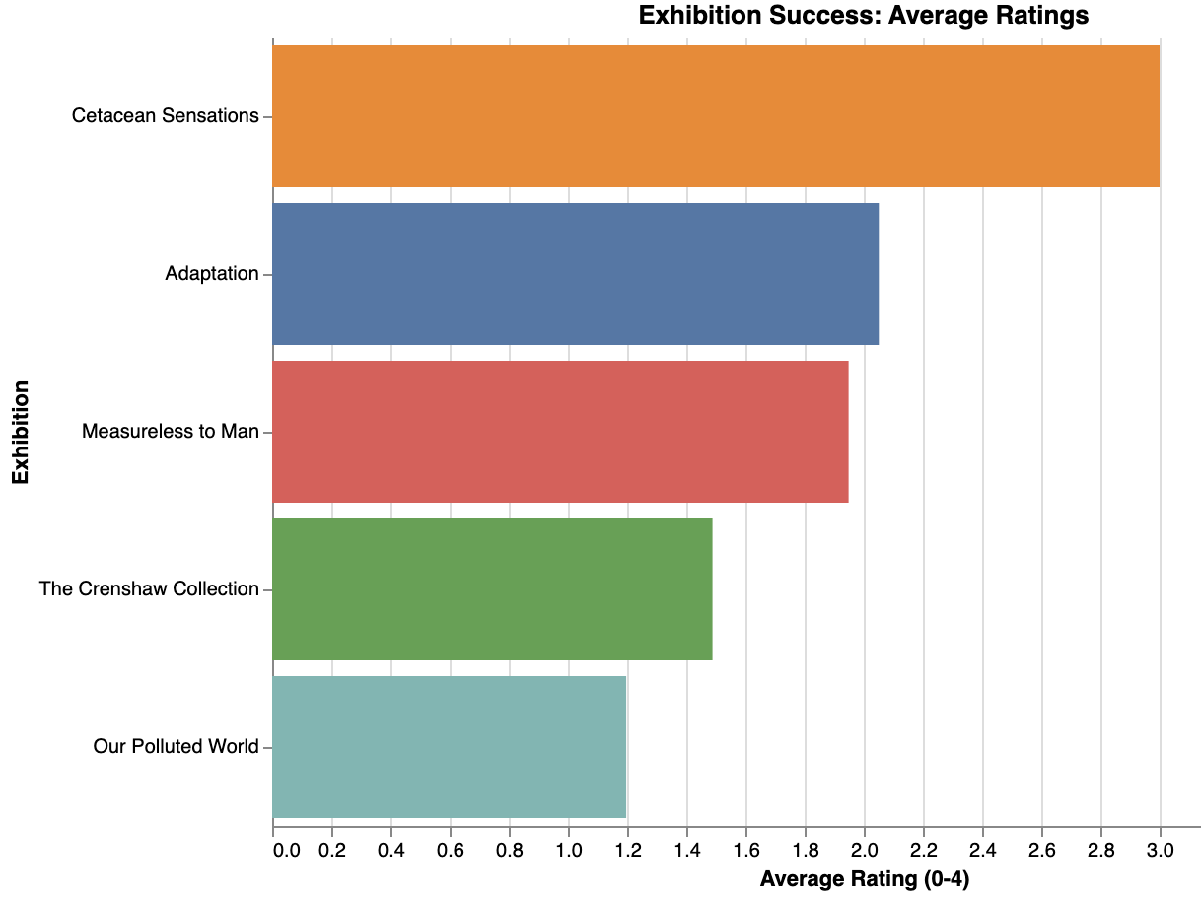
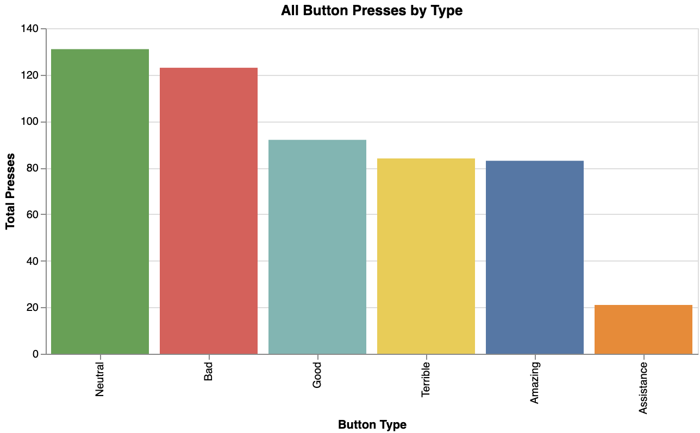
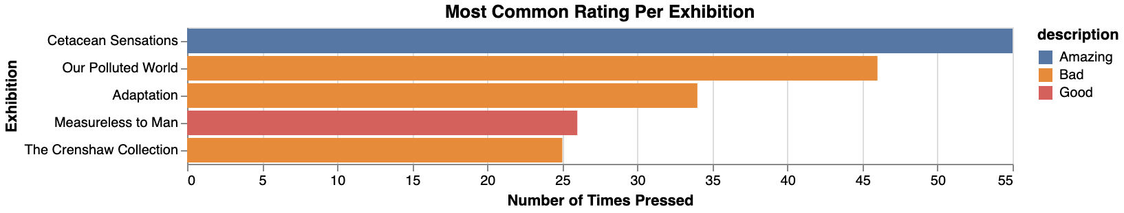
Visitor Experience
🌟 Cetacean Sensations: Visitors love it (Amazing) 😐 Our Polluted World & Adaptation: Most common is Bad - action needed
Notes:
Angela - Exhibition Performance:
Top performers: Cetacean Sensations (most "Amazing" ratings), Measureless to Man (mostly "Good")
Concern: "Neutral" is most common overall - opportunity to elevate experience
Action needed: Several exhibitions have "Bad" as most common rating - requires investigation
Interesting pattern: Cetacean Sensations had both highest ratings AND most assistance requests - does extra support improve satisfaction?

Slide 8
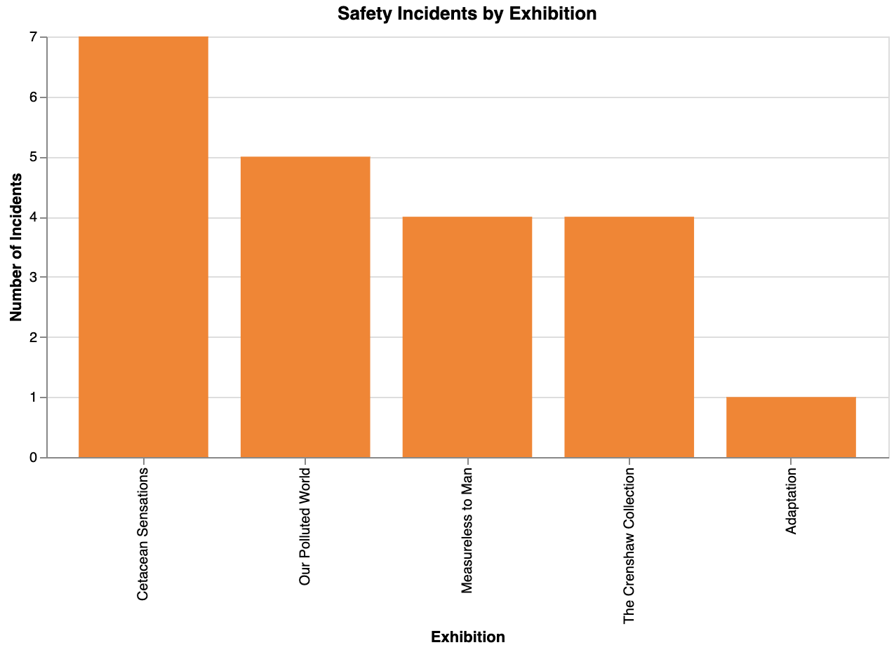
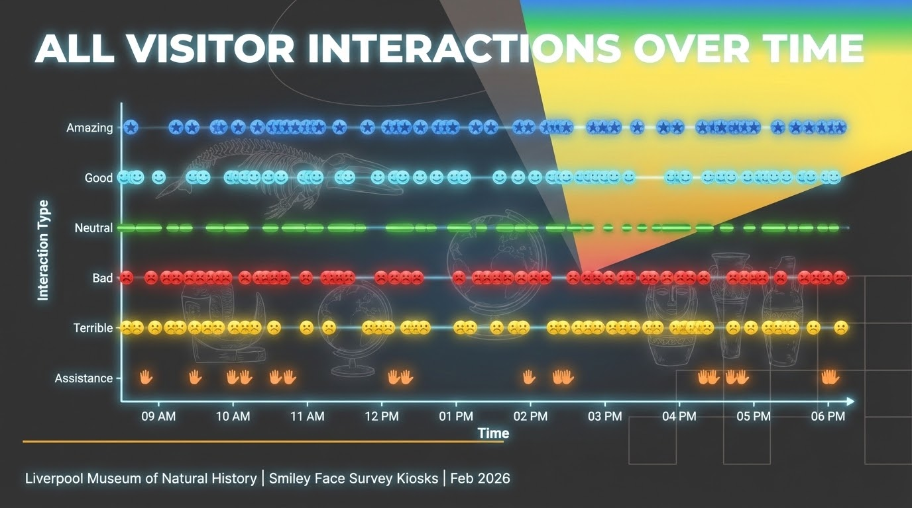
Visitor Safety:
When & Where Help Is Needed
⚠️ Cetacean Sensations has most assistance requests (7)
✅ Adaptation has fewest incidents (1)
Notes:
Rita - Safety & Assistance Patterns:
Good news: Zero emergency button presses - but is the button visible/accessible enough?
Peak assistance times: 9-11am, 12-12:30pm, 2-2:30pm, 4:30-6pm
Lowest incidents: Adaptation exhibition - worth studying what they're doing right
Recommendation: Staff patrol schedules should match these peak times

Slide 9
